Slide 1


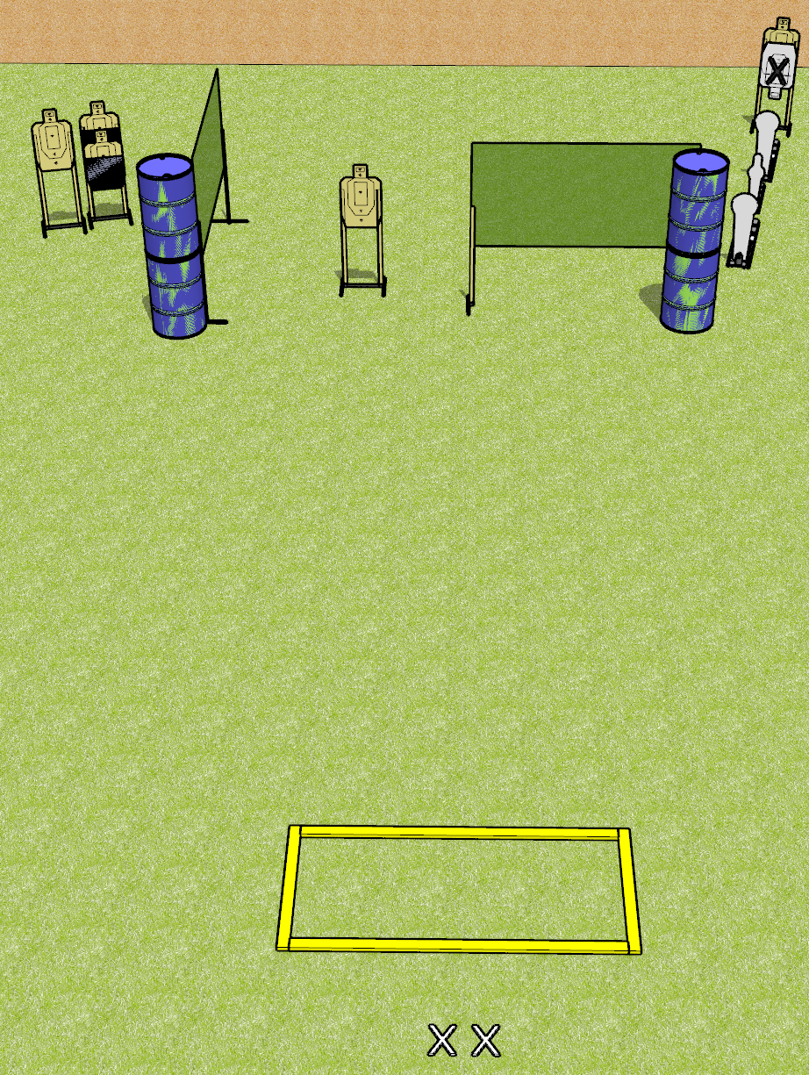
 | Dothan Gun Club – USPSA Match Who Course Designer : Patrick Free
Round Count 11 Rounds 5 USPSA targets 2 colt poppers, 1 mini popper
Equipment List 4 wall feet 2 medium fault lines, 2 8’ fault lines 2 50% hard cover

Slide 2
Who
Written Stage Briefing
Who is an 11 round, 55 point, Comstock course of fire. There are 5 USPSA targets, 2 colt poppers, and 1 mini poppers. The best 2 hits on paper will score, and steel must fall to score. The start signal is audible.
Handgun start position is feet on X’s, wrists above shoulders. Handgun is UNLOADED and holstered.
PCC start position is feet on X’s. UNLOADED carbine is held with both hands, stock on belt.
On start signal, engage targets as they become available from within the shooting area.

